Slide 1

US Share Fund
”Invest & Financial Partner”
Private Equity
Debt Capital Markets
Islamic Finance
Sukuk Structuring
Funding Preparation
Business Financing

Slide 2
US SHARE FUND Patentials
The GCC (Gulf countries) are situated on the richest area of the world in terms of petrol and energy reserves and have 2.5 trillion dollars of fund source. The Gulf countries have been spending 1.8 trillion dollars of these funds for overseas investments.
Owning 35% of total fund sources of the world, the Gulf countries have been working with different instruments than western-sourced investments. The Gulf countries composing of the countries such as Qatar, Oman, Bahrain, United Arab Emirates, Saudi Arabia and Kuwait have preferred interest free instruments while investing.
The Gulf countries have been trying to lead their assets to safe investments. Due to the economic stability in recent years, its trust, safety, in terms of investor protection and the business familiarity with gulf countries, US has been a candidate to be the center of the investments of Gulf Countries.

Slide 3
Gulf –US Capital
GulfUS Capital and US SHAREFUND is a leading alternative Financial Service Company that is focused on building dynamic, profitable, and reputable finance and investments in the United States.
The US Share Fund operates in accordance with the principles of interest-free financial model as a participation fund, with bonds and profit sharing accounts, and lending such funds through production support, finance lease and profit/loss sharing partnership.
Our company mission is to develop joint projects and collaborations in economic and financial areas between US and Gulf countries investors, funds and entrepreneurs, local and private institutions and financiers to develop business.
Gives services to establish Gulf based investor partnerships, consortiums, provide financing, Leasing, Venture Capital (private equity), Share transfer (Buyout), Interim Financing (Mezzanine), Fund configuration services.

Slide 4
Gulf-US Capital Services
Real Estate Finance
Owner To Owner
Buyout
Developer Purchase
Construction Finance
Equity Release
Non-Resident Home Finance
Small Business Finance
Working Capital Finance
Goods Finance
Flexi-business Finance
Fixed Asset Finance
Business Vehicle Finance
Private Equity
US Share Bond s
Leaseback US Share Bond
Investing US Share Bond
Commodity US Share Bond
Cooperation US Share Bond
Commercial US Share Bond
Corporate US Share Bond
Convertible US Share Bond
International US Share Bond
Personal Finance
Car Finance
Education Finance
Travel Finance

Slide 5
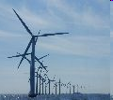
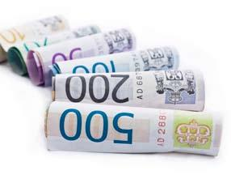
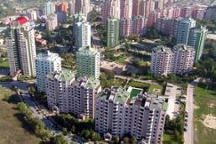

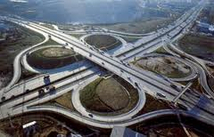
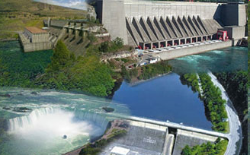
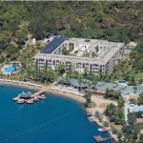
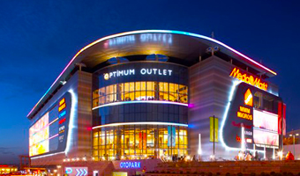
For the projects of PPP-INFRASTRUCTURE-
TRANSPORTATION-HEALTH-ENERGY
INDUSTRY-REAL ESTATE
“Realizing a new project, developing the current projects”
Gulf-US Financial Sevices www.GulfUSCapital.com

Slide 6



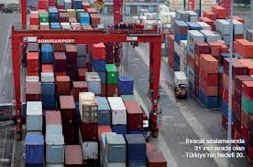
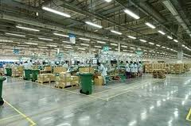


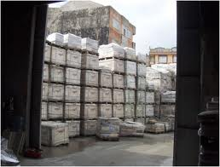
For Purchase-Selling Operations of
Commercial-Industrial
Commodities and
Services
Gulf-US Financial Sevices www.GulfUSCapital.com

Slide 7
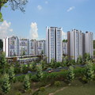

For the operations of Renting-Usufruct-licensing-
Partnership-Forfeiting
Gulf-US Financial Sevices www.GulfUSCapital.com

Slide 8
Sorts of « SHARE FUNDS» POTANTİALS
With US SHARE FUNDS;
For Realizing a new project, Developing a current project or any commercial operation …
For Purchase-Selling operations of Commercial Commodities and Services …
For the operations of Renting and Usufruct ….
For the Rights and Possession of Property ….

Slide 9
Real Estate Investment Funds
Real Estate Investment Funds; is a type of capital market institution which is founded in order to issue its shares for the purpose of operating and managing a portfolio composed of real estates, real estate projects, real estate-based rights, infrastructural investments and services, capital market instruments,
Funds are allowed to engage only in management of portfolios comprised of the following assets and transactions:
a) Real estates and property rights,
b) Private and public debt instruments,
c) Foreign private and public debt instruments
ç) Time deposit and participation account;
d) Investment fund units;
e) Lease certificates and real estate certificates;
f) Cash collaterals and premiums of derivative transactions;
ı) Specially designed foreign investment insturuments

Slide 10
“US Share Funds” Scope and Bond Types
Leaseback Share Fund ;
Investing Share Fund ;
Partnership Share Fund ;
Commodity Share Fund ;
Cooperation Share Fund ;
Commercial Share Fund ;
Corporate Share Fund ;
Convertible or exchangeable Share Fund,
Domestic Share Fund ;
Global Share Fund ;
Hybrid Share Fund ;
International Share Fund
Quasi-sovereign Share Fund ;
Sovereign Share Fund ;

Slide 11
REAL ESTATE-HOME LOANS
DEVELOPER PURCHASE
Financing of up to USD 5 million for USA Nationals and for expatriates
Six months optional grace period (for Salary Transfer customers)
Our Banks paid property insurance for the full tenure
Financing of up to 80% of property value.
No early settlement fees when selling the property
Free partial settlement of up to 30% outstanding annually
Salary transfer is optional
Financing available for self-employed applicants
Automatic upgrade to Our Bank Priority Status (for Salary Transfer customers)
Transactional Cost Financing available (for Salary Transfer Customers)
CONSTRUCTION FİNANCE
Financing of up to USD 5 million
Competitive pricing with your best interest in mind
Up to 25 years repayment period
Finance payments set upon percentage completion
Ability to utilize Private Housing Loan Authority funds to start construction
Contractor / Consultant approval process is available

Slide 12
REAL ESTATE-HOME LOANS-2
EQUITY RELEASE
Release equity of up to 80% of the value of your home.
Enjoy competitive profit rates
Customise your financing to fit your needs
NON-RESIDENT HOME FINANCE
Financing of Up to 50% of property value
Finance up to USD 5 million (for up to 2 properties)
Financing period up to 25 years
No proof of income in USA required
Take cash out of your existing property in the USA
USA PROPERTY FINANCE
Up to 25 years tenure
Up to USD 5 million or 70% of property value
Finance available for salaried and self-employed customers

Slide 13
TRADE FINANCE SOLUTIONS
Export LC Advising and Confirmation
Export Collections
Export Financing / Wakala
Inward Bills for Collection, IBC Murabaha and Avalization
Documentary Letters of Credit & LC Murabaha
Letters of Guarantee
Open Account Goods Finance
Shipping Guarantees
FİXED ASSET FINANCE
Short-term financing solution available up to 72 months
Reasonable and acceptable collateral requirements
Flexible repayments
Less documents
Free Business Current Account
USA-registered Entities that have been in the market for at least 4years.
Annual sales turnover between USD 3 Million and USD 30 Million.
Trading, manufacturing or service providing companies with Shari'a Compliant operations, registered in the USA.

Slide 14
UMBRELLA SHARE FUND;
It is deﬁned as “Certiﬁcates of equal value representing undivided shares in ownership of tangible assets, usufructs and services or (in the ownership of) the assets of particular projects or special investment activity”.
Leaseback Share Fund
Investing Share Fund
Partnership Share Fund
Emtea Share Fund
Cooperation Share Fund
Commercial Share Fund
Corporate Share Fund
Convertible or Exchangeable Fund
Domestic Share Fund
Global Share Fund
Hybrid Share Fund
International Share Fund
Quasi-Sovereign Share Fund
Sovereign Share Fund

Slide 15
PRIVATE EQUITY
Our Private Equity strategy is to acquire strategic stakes in highly profitable and fast growing companies in select industries in the USA region and, through active ownership, accelerate their growth and profitability ahead of an eventual exit. We are active investors with a particular focus on operational improvements and regional or product expansion.
PRIVATE EQUITY Methods
* Mergers and Acquisitions;
* Development and Growth Capital;
* Transformation in the Family Businesses and Holdings
* Institutional restructuring;
* Secondary shares in companies open to the public traded under par

Slide 16
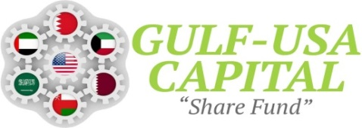
One Liberty Plaza, 165 Broadway 23rd Floor, New York, NY 10006
P: +(1845)480-8762 - F: +1(646)759-3601
Nassima Tower, 04th floor, Sheikh Zayed Road, Dubai
www.GulfUSCapital.com, sharefund@gulfuscapital.com
Business Centers in GCC
Al Fardan Office Tower, 8th Floors , Al Funduq 61 West Bay, Doha,QATAR
Al Hilal Bank Building, Falah Street, PO Box 129 354, Abu Dhabi,UAE
Bin Sulaiman Center, 5th floor, Al Khaldiya district, Jeddah, SA
Al Hamra Tower, 35th floor, East Maqwa, Kuwait City, KUWAİT
Al Nahdah Road , Tamimah Building 2nd Floor, PO BOX 395, Muscat,OMAN
Diplomatic Area , Trust Tower, 2nd Floor, P.O. Box no. 2215, BAHRAİN
Beybi Giz Plaza ,26th Floors ,Maslak CBD, PO BOX 34396 Istanbul TURKEY

