Slide 1
Elitsimultaneous
for all events, meetings, seminars, and conferences … religious-cultural-communities-donation meetings…
***
With our services the Speakers' audience reaches thousands of people outside of the physical space.
Your audience listens to translation through the mobile app on their smartphones with Bluetooth supported digital or wired headphones
***
You can use your own interpreters or request them from us.
All our professional interpreters are experts in simultaneous interpretation.

Slide 2
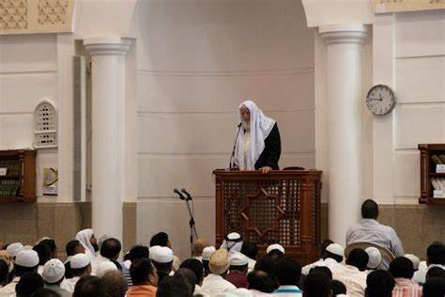

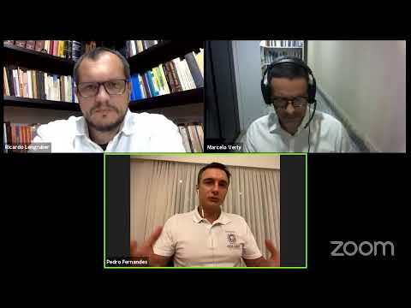

elitsimultaneous
For your organizations

Slide 3
ELIT SIMULTANEOUS INTERPRETING SOLUTIONS
for all events, meetings, seminars, and conferences and religious-cultural-communities-donation meetings…
With our services, the Speakers' audience reaches thousands of people outside of the physical space.
Elite Interpreter Supported Zoom Meetings and Webinar Event Programs from different languages,
It is suits every kind of events.
For all Online Zoom meetings and Webinar events
ELIT SIMULTANEOUS INTERPRETING SOLUTIONS
works alongside the zoom meeting and conferencing programs of your choice.
Attendees who join the elitsimultaneous listen to the translation through the mobile app on their smartphones with Bluetooth supported digital or wired headphones

Slide 4
Elitsimultaneous

Slide 7
Zoom meeting and webinar comparison
The Meeting and Webinar platforms offer similar features and functionality but have some key differences.
Meetings are designed to be a collaborative event with all participants being able to screen share, turn on their video and audio, and see who else is in attendance.
Webinars are designed so that the host and any designated panelists can share their video, audio and screen.
Webinars allow view-only attendees. They have the ability to interact via Q&A, Chat, and answering polling questions.
The host can also unmute the attendees. Attendees in webinars, can not rename themselves as well. After the host clicks
Start, the interpreters will receive a message that they have been assigned a language.

Slide 8
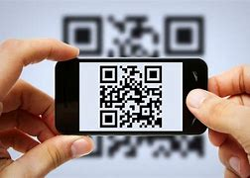
ANNOUNCEMENT SAMPLE
Our valued community;
You can download this link to your mobile phones to listen to our speakers with instant simultaneous translation.
Our Speech and Translation Program will be held on ...............,
between hours ..../.......
You can click:
https://EliteInterpreterSupportedOnlineMeetings……limk or QR code
11 for AR-EN, 22 for AR-TR, 33 for AR-URDU.
Translators will give you instant simultaneous translation from your language.
Our members outside our meeting place and anyone who wants can connect and listen from their home, workplace and all venues.
In order to listen to the translations, you can listen with your mobile phones and Bluetooth with your headphones or with wired headphones.
You can help from the …………………. link and Chat for DONATE for our organization.

Slide 9
Our program links and Chat messages are directed by the DONATION links of the organizations using our service. In this way, service fee and other benefits are earned.
With our services, the Speakers' audience reaches thousands of people outside of the physical space.
Provide us the details of your event and get a quote within 24 hours. You can engage by sending a note to our multilingual customer services at the Contact; https://myinvestsupport.com/global-connect/ elitsimultaneous@elitgroup.shop
WhatsApp for text message; +1.973-938-20-39

